Slide 1
MBQIP Open Call for Minnesota Critical Access Hospitals (CAHs)
August 14, 2024
11:00 p.m. - 12:00 p.m.
Notes:
Senka

Slide 2
Agenda
MBQIP Reporting - Data Submission Reminders
HCAHPS Update on Final Rule
Social Drivers of Health Learning Action Network (LAN) Overview and Participants Efforts Sharing
Notes:
Senka

Slide 3
MBQIP Data Reporting Updates
Notes:
Senka

Slide 4
MBQIP 2025: Updated Core Measure Set
Current MBQIP Core Measure
New MBQIP Core Measure
Minnesota Critical Access Hospital Reporting and Improvement Assistance - Stratis Health
Global Measures | Patient Safety | Patient Experience | Care Coordination | Emergency Department
CAH Quality Infrastructure Implementation* Hospital Commitment to Health Equity* | Healthcare Personnel Influenza Immunization* Antibiotic Stewardship Implementation* Safe Use of Opioids (eCQM)* | Hospital Consumer Assessment of Healthcare Providers and Systems (HCAHPS) | Hybrid All-Cause Readmissions* Social Determinants of Health (SDOH) Screening* SDOH Screen Positive* | Emergency Department Transfer Communication (EDTC) OP-18 Time from Arrival to Departure OP-22 Left without Being Seen*
Nine measures are reported once annually (* denotes annual submission)
Three measures reported quarterly (HCAHPS, EDTC, OP-18)
Notes:
Karla – italics are new measures being added to the core MBQIP starting in 2025. All new measures will be reported annually.
With the new measures coming in 2025 we have a shift in the domains of MBQIP. We now have 5 domains – global measures, patient safety, patient experience, care coordination, and emergency department.
Those measures marked with a red star are current measures that you are already reporting.
Those measures in italics are new measures being added to the MBQIP core set starting in 2025 – and as noted by the asterisk, all of them are annually reported measures. The new measures include the CAH Quality Infrastructure Implementation measure which is collected via the National CAH Quality Inventory and Infrastructure Assessment – the survey most of you completed for the first time late last year.
The Hospital Commitment to Health Equity which we’re going to talk about more in a bit.
The Safe Use of Opioids electronic clinical quality measure – which is a part of the promoting interoperability program and most of you are already reporting.
The Hybrid All-Cause Readmissions measure – which is calculated by combining clinical variables submitted by you all via QCDR with claims data
And the two social drivers of health measures – one being a performance measure of rate of screening of adult inpatients for the five health-related social needs defined in the measure (food insecurity, housing instability, difficulties with utilities, transportation needs, and interpersonal violence); the other is the screen positive rate – importantly this is NOT a performance measure, rather a reflection of the needs of the community being served.
Note that there are only three measures in the 2025 core set that are reported quarterly – HCAHPS, EDTC, and OP-18.

Slide 5
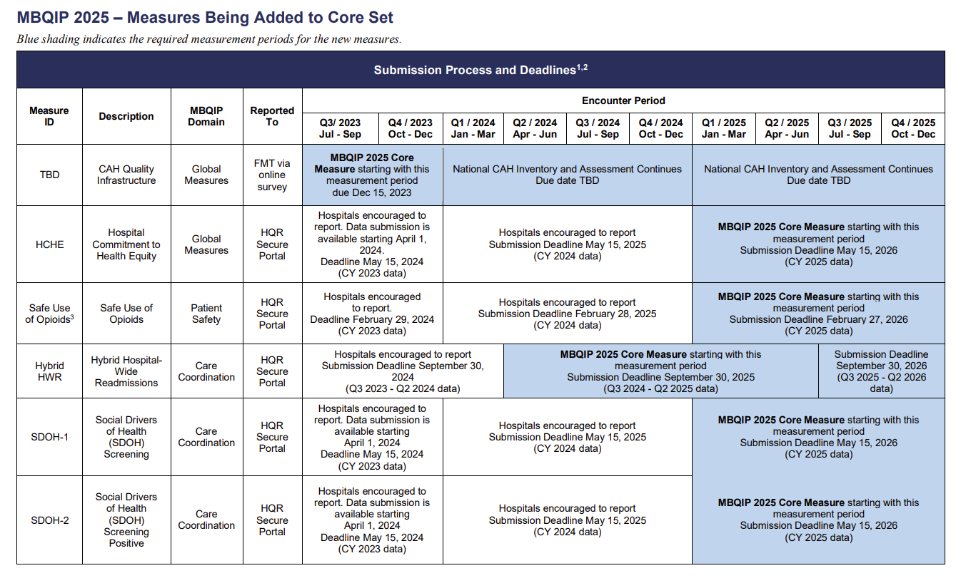
Notes:
Karla
July – HCHE and Safe Use of Opioids
August – SDOH1/2

Slide 6
2025 MBQIP Measures Reporting Timeline
Existing MBQIP core measures set:
Continue to report as usual
New MBQIP measures being added to the core set:
Encouraged to start reporting in 2025 for CY 2024 encounters*
Expected to report data in 2026 for CY 2025 encounters*
*Exception for reporting timeline is Hybrid Hospital Wide-Readmission measure.
Resource on specifications and reporting timelines: MBQIP 2025 Core Measure Set and Data Submission Deadlines (stratishealth.org)
Notes:
Karla
As far as timing – continue to consistently report the current measures (those marked with a star).
For the new measures, you are strongly encouraged (and we are available to support you) to report calendar year 2024 encounters and you will be expected to report your calendar year 2025 encounter data as part of the MBQIP core set. Let’s take a look at the data submission deadlines chart on the next page because it’s a bit confusing to discuss without a visual.

Slide 7
MBQIP Data Reporting Upcoming Due Dates
EDTC Q3 2024 due October 31st (MHA Portal)
OP-18 Q2 2024 due November 1st (Hospital Quality Reporting)
HCAHPS Q2 2024 data due October 2nd submitted to HQR by your vendor
Population and Sampling is optional.
NEW MBQIP Measure Encouraged to submit:
Hybrid Hospital Wide Readmissions (HWR) Q3 2023 - Q2 2024 data due September 30, 2024.
On-Demand Webinar for Hybrid Measures data submission: FY 2026 Hybrid Measures Data (qualityreportingcenter.com)
Notes:
Senka

Slide 8
HCAHPS Updates

Slide 9
HCAHPS Changes: Finalized in the 2024 IPPS Rule
HCAHPS Survey Administration changes starting January 2025:
Incorporate web-based options to modes of survey administration (web-based option is via email distribution)
Allow patient proxy to complete the survey
Extend data collection period to 49 days (from 42 days)
Limit supplemental items to no more than 12
Require collection of information about language that the patient speaks while in the hospital, and require official Spanish translation be administered to all patients who prefer Spanish
Source: 2024 IPPS Final Rule;
Additional information: Survey Protocols, Response Rates, and Representation of Underserved Patients: A Randomized Clinical Trial | JAMA Network
Notes:
These changes have already been finalized in last year’s rule making process
(Web-Mail mode, Web-Phone mode, and Web-Mail-Phone mode) in addition to the current Mail Only, Telephone Only, and Mail-Phone modes, beginning with January 2025

Slide 10
HCAHPS Changes: Finalized in the 2025 IPPS Rule
CMS has finalized changes to the HCAHPs survey and measures starting with January 1, 2025 discharges.
Updates to the survey can be found here: Updated HCAHPS Survey (hcahpsonline.org).
Has been referred to as HCAHPS 2.0
Notes:
These changes are still proposed – as part of IPPS 2025 Rule – final rule typically comes out in September.
CMS no longer referencing this as HCAHPS 2.0 – but that terminology is still sometimes being used.

Slide 11
HCAHPS Changes Cont’d…
Updates to survey questions and measures:
Adding, removing, and changing multiple questions
Revised survey will have 32 questions (currently 29)
Updates the ‘about you’ questions
Sub-Measures: (Currently 10, will be 11)
Removes existing Care Transitions sub-measure
Adds two new measures:
Care Coordination
Information about Symptoms
Modifies existing Restfulness of Hospital Environment sub-measure
Details: Updated HCAHPS Survey
Notes:
Several minor changes to “About You” item wording, sequence, and response options

Slide 12
Survey Questions That Will be Removed
Survey Questions That Will be Removed | Current Sub-measure
During this hospital stay, after you pressed the call button, how often did you get help as soon as you wanted it? | Responsiveness of Hospital Staff (revised)
During this hospital stay, staff took my preferences and those of my family or caregiver into account in deciding what my health care needs would be when I left. | Care Transitions (removed)
When I left the hospital, I had a good understanding of the things I was responsible for in managing my health. | Care Transitions (removed)
When I left the hospital, I clearly understood the purpose for taking each of my medications. | Care Transitions (removed)
During this hospital stay, were you admitted to this hospital through the Emergency Room? | n/a - Descriptive
Notes:
Out-dated technology (i.e. call buttons)
Indicated they have been testing and asking for patient input on the updated questions and framing

Slide 13
Survey Questions That Will be Added
Survey Questions That Will be Added | Updated Sub-measures
During this hospital stay, how often were you able to get the rest you needed? | Restfulness of Hospital Environment (revised)
During this hospital stay, did doctors, nurses and other hospital staff help you to rest and recover? | Restfulness of Hospital Environment (revised)
During this hospital stay, when you asked for help right away, how often did you get help as soon as you needed? | Responsiveness of Hospital Staff (revised)
During this hospital stay, how often were doctors, nurses and other hospital staff informed and up-to-date about your care? | Care Coordination (new)
During this hospital stay, how often did doctors, nurses and other hospital staff work well together to care for you? | Care Coordination (new)
Did doctors, nurses or other hospital staff work with you and your family or caregiver in making plans for your care after you left the hospital? | Care Coordination (new)
Did doctors, nurses or other hospital staff give your family or caregiver enough information about what symptoms or health problems to watch for after you left the hospital? | Information about Symptoms (new)
Was this hospital stay planned in advance? | N/A - Descriptive

Slide 14
HCAHPS Changes – Care Compare
Public Reporting:
During transition period, only the unchanged sub-measures will be publicly reported.
Proposed - Starting with CY 2025 data, all sub-measures based on the revised survey will be publicly reported
Updated HCAHPS sub-measures anticipated to be released during the October 2026 Care Compare Refresh
Notes:
HCAHPS publishes 4 rolling quarters of data at a time.

Slide 15
SDOH LAN Overview and Participants Efforts Sharing
Notes:
Spotlight new MBQIP measures on Open Calls: April: CAH QI Infrastructure and HHWR July: HCHE and HCAHPS proposed changes
August: SDOH1-SDOH2

Slide 16
SDOH/HRSN LAN Goal
Support Minnesota CAHs in implementing or advancing existing actions to screen for health-related social needs and social drivers of health. Focus areas will include:
Screening process and data collection for reporting and measure improvement to meet the requirements of the new MBQIP 2025 measures set.
Use of the data to identify opportunities for improvement.
Understanding how to form or leverage existing relationships with the social service resources in the community to address HRSN/SDOH.
Timeline: April – August 2024
By the end of this LAN, CAHs will have the tools and information to support the development and implementation of an action plan to screen for and address HRSN/SDOH.
Notes:
Marleny
Facilitated space that is safe for everyone to voice their ideas
Share the space by raising hands to talk in small groups
Remember, any progress – no matter how big or small – is important.

Slide 17
The LAN Content
Session #1: Building a CAH strategy on SDOH/HRSN and Understanding new SDOH measures in the 2025 MBQIP core measures set
Session #2: Developing and Implementing Screening Workflow and Data Collection
Session #3: Engaging Community Partners
Session #4: Action Plan Implementation and Progress Monitoring/Informing Community Members and Other Key Constituencies
August MBQIP Open Call: Sharing of efforts and lessons learned
Notes:
Marleny

Slide 18
Participating CAHs
Thank you to the following CAHs for their participation in this inaugural SDOH LAN.
Avera Marshall Regional Medical Center
Bigfork Valley Hospital
Cass Lake IHS
Cook Hospital & Care Center
Cuyuna Regional Medical Center
Glacial Ridge Health System
Johnson Memorial Health Services
LifeCare Medical Center
Mille Lacs Health System
Murray County Medical Center
River's Edge Hospital
Sanford Canby Medical Center
Sanford Luverne Medical Center
Sleepy Eye Medical Center
Windom Area Health

Slide 19
Component 1: Building a CAH strategy on SDOH/HRSN and Understanding of new SDOH measures in the 2025 MBQIP core measures

Slide 20
CAH SDOH Strategy
Organize the SDOH Governance Committee to develop and advise strategy implementation
Consider the internal and external make-up of the committee – intent is to build the case for addressing SDOH, the buy in and provide ongoing guidance for the CAH’s strategy
Communicate SDOH strategy internally and externally
Consider infrastructure needs for reporting the data
Notes:
Senka

Slide 21
SDOH/HRSN Strategy Governance
Who:
Organizational champion
Leader champion to provide advocacy for resources and buy in from staff; EHR changes; community engagement/relationships
Committee (e.g., quality committee);
Consider who needs to be on the committee (e.g., front line staff, IT, quality manager, a community member/patient)
What does the committee do:
Helps establish strategy for screening and addressing positive screens
Develop action plan and timeline and monitor
Data review
PDSAs
Notes:
Emphasize the “who” is on the committee: senior lead, diversity of perspectives…..
Think about a breakout or question on if they have this in place already

Slide 22
Understanding of MBQIP Measures
Two New MBQIP Measures:
SDOH-1: Screening for Social Drivers of Health
SDOH-2: Screen Positive Rate for Social Drivers of Health
Screens for 5 SDOH domains: Food insecurity, housing instability, transportation needs, utility difficulties, and interpersonal safety
Numerator/Denominator data reported through HQR
Intended for inpatient setting.
Reporting encouraged now; expected starting in May 2026 for CY 2025.
Notes:
Senka

Slide 23
Discussion Reflection
Where have you experienced growth in this component?
What are continued barriers and opportunities you see in moving forward?
What additional resources would be helpful?

Slide 24
Component 2: Developing and Implementing Screening Workflow and Data Collection

Slide 25
Screening Workflow and Data Collection
Develop the screening process (tool, staff, setting)
Map out the screening process
Data collection – gathering and reporting
Risk stratification
Staff education and involvement
Patient and family considerations
Notes:
Senka

Slide 26
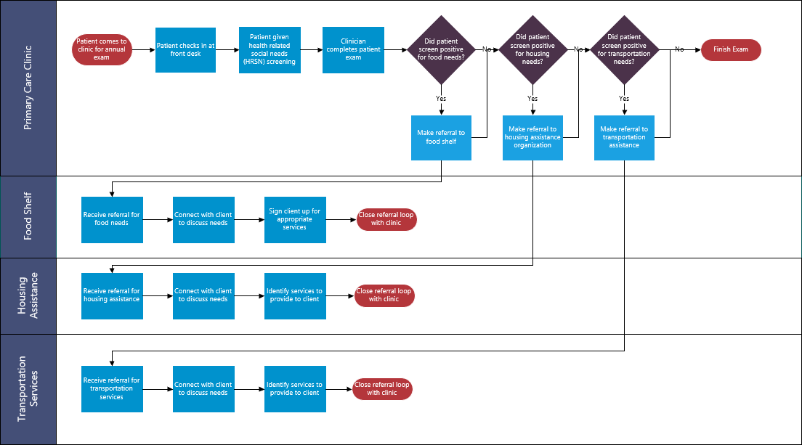
Social Needs Referrals
Notes:
In this second swim lane process map example, which we’ll create together in just a few minutes, we zoom out a bit and are now using the same set of tools and techniques to depict a process that takes place across multiple organizations: a food shelf, a primary care clinic, a housing assistance organization and a legal services organization. Of course each organization will have many roles (as we saw in the previous primary care clinic process), but at this level, we are concerned about how multiple organizations in a community interact to complete the multi-stakeholder process of screening and referring patients and community members to one another.
You’ll also note in this example that the process can end in multiple ways, at the primary care clinic or when services have been delivered by the housing and/or legal services organizations (as indicated by multiple circles which terminate the process on the right hand side of the diagram). The processes within each organization are likely much more complicated with more steps and decision points than depicted on this map, but the point is to document the process to the level needed by the collaborative team. Each organization could, if desired, map out the individual processes that occur within their organization, just as we saw in the previous primary clinic example.
The example here may seem complex if you are seeing a swim lane process for the first time, but keep in mind we are limited by the size of your screen. With a large white board or using a wall in a conference room, the swim lanes can become much longer and the number of swim lanes can also be increased to accommodate more process actors.
Our final example is multi-organizational and depicts the process of referring individuals to various services based on identified health-related social needs. In this example, the four lanes include the Primary Care Clinic, food shelf, housing assistance, and transportation services. The process map starts when a patient comes to the clinic for an annual exam. The patient checks in at the front desk and is given a health-related social needs screening. After the clinician completes the patient exam, the process map directs the clinician to answer three questions – did the patient screen positive for food needs? If yes, make a referral to the food shelf. The next question is, did the patient screen positive for housing needs? If yes, make a referral to housing assistance. And finally, did the patient screen positive for transportation needs? If yes, make a referral to transportation assistance. Then, the clinician finishes the patient exam.
The other three lanes depict what each service organization does upon receiving a referral, including connecting with the client to discuss needs, signing the client up for appropriate services, and closing the referral loop with the clinic.
As with the previous module, it is important to note that these examples are simplified for the purposes of this course and demonstrating the concepts related to swim-lane process mapping. In this case, the steps in the process are very high-level, and each organization will likely require its own process map to depict its operating procedure for processing referrals received from the primary care clinic. However, hopefully, you can see how swim-lane process mapping can be a useful tool for clarifying understanding of roles and how processes between organizations are interconnected.

Slide 27
Characteristics of Screening Tools
Screening Tools Characteristics | American Academy of Family Physicians | Accountable Health Communities | PRAPARE
# of social needs questions | 15 | 19 | 17
# of non-social needs questions | 0 | 8 | 4
Reading Level | 7th grade | 8th grade | 8th grade
Additional Languages | Yes (1) | No | Yes (25)
Scoring | Yes | Yes | No
Cost | Free | Free | Free
Domains Covered
Food Insecurity | X | X | X
Housing Instability | X | X | X
Transportation Challenges | X | X | X
Utility Difficulties | X | X | X
Interpersonal Safety | X | X | X
Adapted from: Social Needs Screening Tool Comparison Table | SIREN (ucsf.edu)
Notes:
Marleny
Pediatric specific screening tools are available

Slide 28
Community and Culturally Responsive Considerations
People with Behavioral needs
Older Adults
People Living with Disabilities
Literacy levels
Racial and ethnic groups
People for whom English is not a primary language
People who identify as LGBTQA+
Access to and/or adoption of technology
Notes:
Marleny
Patients may lack trust in the staff, providers, or health care system, and it may take longer to screen them.
Patients may refuse screening because of stigma, fear of losing independence, or privacy concerns
Staff may have unconscious biases or make assumptions based on patients’ ability.
Consider: Patient experience. Aim for minimal disruption by considering how screening impacts the following aspects of the visit: - Flow through the space, including how easy it is for the patient to get from one point to another. Avoid having the patient retrace their steps through the site (such as returning to the waiting room) to participate in screening. - Emotional experience, such as how welcoming and knowledgeable the staff are. Aim for the screening to be a positive experience with minimal disruption, reassuring the patient that screening will not affect clinical care. - Length of visit, including how much additional time is required for screening. Aim for the screening to be brief (5–10 minutes) and not impact the patient’s time with the provider. • How referrals take place. Determine how patients who screen positive for HRSNs will be referred to community resources and/or to staff who will assist them in addressing these needs. • When screening occurs. Consider the points at which screening could occur (for example, before the visit, during check in, when vitals are collected, and after the visit) to identify when to conduct it. Consider who will score the screening tool to determine positive screening results and whether a referral is necessary. • Appropriate space for screening. Because screening includes sensitive questions, consider using a private area to create a respectful and safe environment. • Appropriate accommodations. Specify procedures for providing reasonable accommodations for people with disabilities or non english speakers. Staff involved. Identify the staff who conduct screening and those who support it, formalize their roles and responsibilities, and educate them on everyone’s role. • Integration with electronic health records or other data systems. Explore ways to increase screening efficiency and data accessibility via integration with existing systems and codes. Refer to the Social Interventions Research & Evaluation Network’s Compendium of Medical Terminology Codes for Social Risk Factors for a crosswalk of HRSN data to the Logical Observation Identifiers Names and Codes (LOINC), the Systematized Nomenclature of Medicine Clinical Terms (SNOMED CT), ICD-10-CM, and the Current Procedural Terminology (CPT). • Modification of clinical workflows to integrate screening.

Slide 29
AIDET
A | Acknowledge | Greet the patient by name and acknowledge any family or friends in the room. Be mindful of body language - make eye contact, smile, when possible, sit at the level of the patient, etc.
I | Introduce | Introduce yourself with your name, skill set, professional certification, and experience.
D | Duration | Give an accurate time expectation for any screenings, tests, physician arrival, etc. When this isn’t possible, commit to a time when you will update the patient on progress.
E | Explanation | Explain step-by-step what to expect next, encourage and answer questions, and let the patient know this is a screening that’s conducted for all patients.
T | Thank You | Thank the patient and/or family and friends for their communication and cooperation.
Adapted from: AIDET Patient Communication | Huron (studergroup.com)
Notes:
Marleny
A Practical Approach to Screening for Social Determinants of Health | AAFP
Workflow for Sutter Health SDOH Pilot. (1) Upon checking in, the... | Download Scientific Diagram (researchgate.net) Workflow for Sutter Health SDOH Pilot. (1) Upon c
AIDET (Acknowledge *Being mindful of body language (not having back to patient, making sure patient is engaged.
Introduce,
Duration (info that would be important to know for patients),
Explanation
Thank You
Important skills for sensitive conversations
AIDET Patient Communication | Huron (studergroup.com)
Full-Toolkit_June-2022_Final.pdf (prapare.org)

Slide 30
Discussion Reflection
Where have you experienced growth in this component?
What are continued barriers and opportunities you see in moving forward?
What additional resources would be helpful?

Slide 31
Component 3: Engaging Community Partners

Slide 32
Identifying Resources
Compile a list of resources in your community that address SDOH
Identify a team that will lead this process
Consider what’s currently available through existing partnerships that the CAH has; start identifying other resources in the community
Review key MN Directories for resource information in your area; add to your homegrown list.
Notes:
Senka

Slide 33
Building a Plan for Community Engagement
Develop a plan to engage community partners into CAH’s strategy to help address SDOH
Share data, communicate, engage local leaders, cultural, faith-based organizations to support
Seek funding opportunities to support SDOH work
Notes:
Senka

Slide 34
Discussion Reflection
Where have you all experienced growth in this component?
What are continued barriers and opportunities you see in moving this forward?
What additional resources would be helpful?

Slide 35
Component 4: Action Plan Implementation and Progress Monitoring/Informing Community Members and Other Key Constituencies

Slide 36
The Model for Improvement - PDSA
PDSA is a methodology to test small changes in a practice's workflow or clinical services. Common questions are used throughout the iterative cycle.
Plan: Develop the Initiative
Do: Implement Your Plan
Study: Analyze the Results
Act: Adjust the Plan or Process
Notes:
Once you have clarified what you want to accomplish, how you will know change is an improvement and what change you want to make, you are ready to test your change ideas. Testing of changes is done in Plan-Do-Study-Act or PDSA cycles.
Resist the urge to skip testing of changes. Teams are often eager just to implement their ideas which they are pretty sure are the best ideas and will work! As a quality improvement leader in your organization, you can encourage systematic testing of changes before full implementation. This will help ensure that you are implementing the right changes in the right way.
Plan
During the plan stage, teams address the following questions:
What change are you testing with the PDSA cycle(s)?
What do you predict will happen and why? Predictions are important because you are testing a theory with the PDSA cycle.
Teams will also address
Who will be involved in this PDSA (for example, one staff member or customer or patient, one time or for one shift or one day – the key is starting with small scale tests. This doesn’t mean you can’t test a big change, but rather, it means to start with testing it on a small scale to learn from it through subsequent PDSA cycles, before implementing more broadly
Teams will plan
When and where will the change be tested
How long the change will take to implement
What resources will be needed and
What data will need to be collected to help understand if the change was implemented as intended and how it worked. Did it have the intended impact, and were any concerns or barriers with implementing the change?
Do
The team then carries out the test as planned, collecting data, and noting observations and findings.
Again, typically changes are tested on a small scale to help build sequential knowledge.
Study
The team then studies and analyzes the data and determines if the change resulted in the predicted outcome.
The team notes any lessons learned, unintended consequences, surprises, successes, or failures, and summarizes what was learned. All this information will guide team decision making about the tested change.
Act
The act stage involves the team deciding to adapt, adopt, or abandon the tested change. The team might modify any aspects of the change and repeat the PDSA cycle. They might adopt the changes and consider broadening the scope of the test – with more people and departments, on additional shifts, etc. Or the team may choose to abandon the tested change and plan a new test of change that may be more beneficial in working towards the goal.
it is important to note that PDSA cycles can test a big impactful change, however, the power of the PDSA is that it can be first used on a small scale, in order to identify barriers and problems early on and to address those, and to sequentially build buy-in and commitment and produce data that demonstrates results.
Keep in mind that PDSA is an iterative process, meaning the process of implementing PDSA cycles continues serially over time, to help ensure the right changes are made in the right way.
The intervention is refined, and the scope or scale is broadened with each cycle. In this way, knowledge is built sequentially.

Slide 37
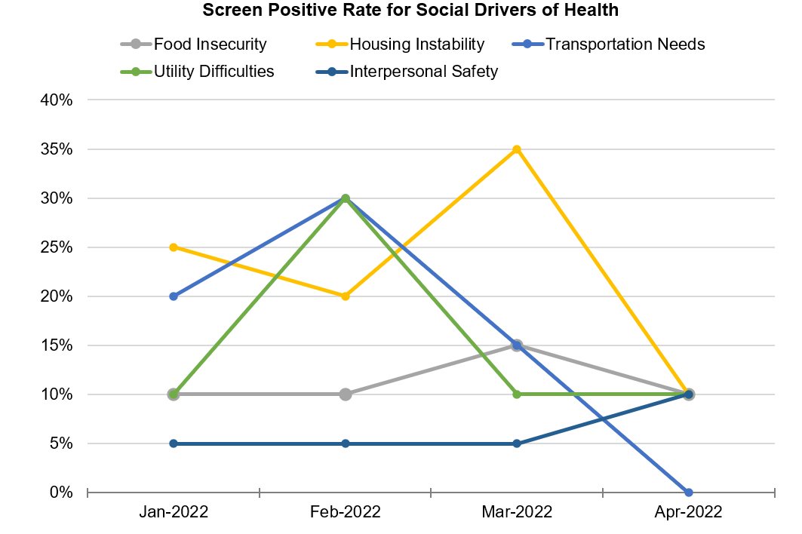
Data Reporting Dashboards

Slide 38
Community level data
Continue to work on and monitor community health needs assessments (connect with your local public health)
County Health Rankings: County Health Rankings & Roadmaps
USDA County Level Data Sets: includes poverty, population, unemployment, education; Atlas of Rural and Small-Town America: USDA ERS - County-level Data Sets
Notes:
Senka

Slide 39
Wrap up
Next SDOH LAN CAH Cohort of 15 CAHs to start in October 2024 (recruitment email in September 2024)
SDOH Toolkit in the works – announcement email in September
MBQIP Website: Minnesota Critical Access Hospital Reporting and Improvement Assistance - Stratis Health
Quality Reporting guide: MBQIP-Quality-Reporting-Guide Minnesota_May 2024 (stratishealth.org)
Contact us with questions: jwinters@stratishealth.org

Slide 40
Stratis Health Project Team
Senka Hadzic, Program Manager shadzic@stratishealth.org
Karla Weng, Senior Program Lead
kweng@stratishealth.org
Jodi Winters, Executive Assistant
jwinters@stratishealth.org
Additional team members to join in September 2024.

Slide 41
Thank you!
This project is supported by the Health Resources and Services Administration (HRSA) of the U.S. Department of Health and Human Services (HHS) as part of an award totaling $225,000 with 0.00 percentage financed with nongovernmental sources. The contents are those of the author(s) and do not necessarily represent the official views of, nor an endorsement, by HRSA, HHS or the U.S. Government.

